Slide 1



TELECOM CUSTOMER CHURN
PROJECT
Presented by: Raj Kadam

Slide 2


DATA DESCRIPTION
Data source explaining
Dataset Name :"Telecom_Customer_Churn.csv"
Context
The Customer Churn table contains information on all 7,043 customers from a Telecommunications company in California in Q2 2022
Each record represents one customer, and contains details about their demographics, location, tenure, subscription services, status for the quarter (joined, stayed, or churned), and more!

Slide 3



Description :
Led a comprehensive analysis of customer churn data for Telecom Company, employing advanced analytics techniques to identify key drivers of churn and implementing targeted strategies for customer retention. Leveraged tools like Python & Power BI for data visualization and interpretation
Key Responsibilities :
Conducted in-depth analysis of telecom customer data, identifying patterns and factors contributing to churn.
Developed predictive models using statistical techniques to forecast and proactively address potential churn scenarios.
Utilized Power BI to create dynamic dashboards for visualizing key metrics related to customer churn, including usage patterns, service dissatisfaction, and billing issues.
Collaborated with cross-functional teams to implement data-driven retention strategies based on the analysis.

Slide 4





Analysis How many customers have unlimited data plans
Unlimited Data :
Yes | No
4745 | 772
Their is 4745 customer has take unlimited data plan and 772 customer has not activated their unlimited plan in California. 65% + customer use unlimited data plan.

Slide 5


Analysis by customers have online security features enabled :
Online Security :
Yes | No
2019 | 3498
There is 2019 person has take online security and the 3498 person has not take online security. only 29% has take online security.
Analysis by the distribution of customers based on gender :
Gender :
Male | Female
3555 | 3488
Male customer has 3555 and female has also 3488 .

Slide 6

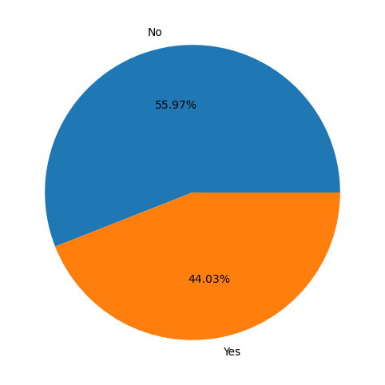
Analysis percentage of customers have subscribed to online backup services :
44.03% customer has subscribed to online backup services .

Slide 7

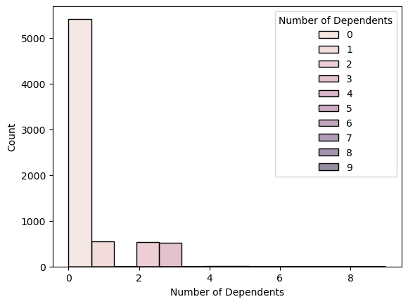
Analysis the average number of dependents per customer :
The average number of dependent customer is 0.46 .

Slide 8


Analysis the percentage of customers have subscribed to online backup services :
Online Backup :
Yes | 2429
No | 3088
44.03% customer has subscribed to online backup services.

Slide 9


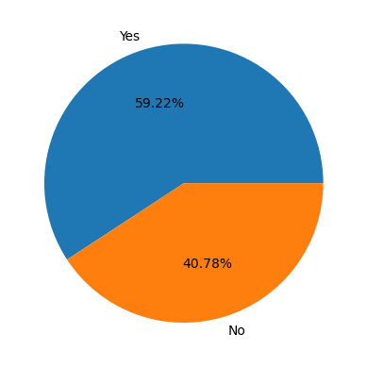



What percentage of customers opt for paperless billing :
Paperless Billing :
Yes | 4171
No | 2872
The 59.22% Customer has using Paperless billing and 40.78% customer has using the paper billing.

Slide 10

Analysis by age impact the types of services customers subscribe to :
Adult | Offer A | 281
 | Offer B | 479
 | Offer C | 190
 | Offer D | 360
 | Offer E | 455
Old | Offer A | 119
 | Offer B | 183
 | Offer C | 139
 | Offer DOfeer
Old
The Adult age group offer B has subscribed by 479 customer, and the Old age group offer E has subscribed by 190 person, also Young age group offer B subscribed by 162 customer , but offer c is good impact on Adult & Young age group and also offer A not impact on the Old age group .
 | Offer D | 121
 | Offer E | 190
Young | Offer A | 120
 | Offer B | 162
 | Offer C | 86
 | Offer D | 121
 | Offer E | 160

Slide 11
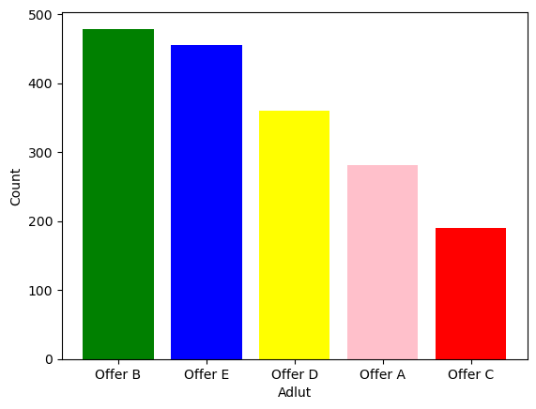
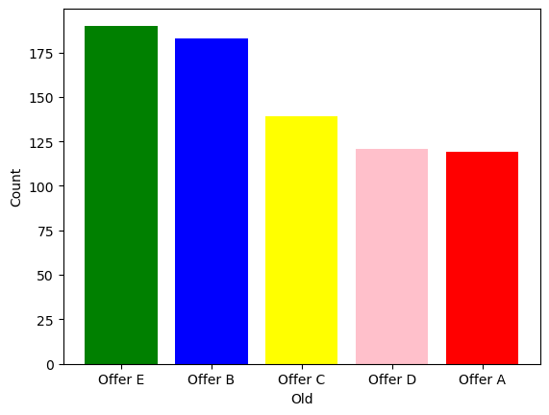
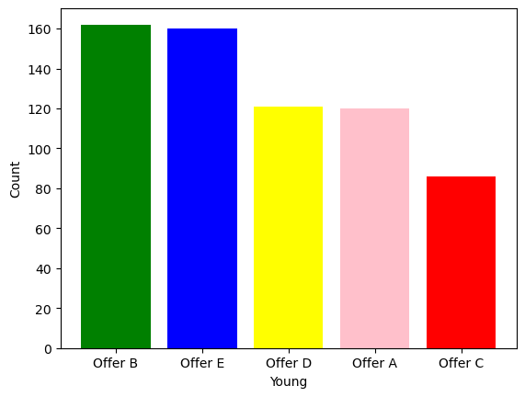

Slide 12

What is the average monthly long-distance charge for customers, and does it vary by demographic top 10 ?
City | Average
Laton | 741.66
Honeydew | 734.89
Lemon Grove | 670.68
Arbuckle | 651.99
Del Mar | 637.62
Orick | 631.10
Alamo | 626.65
Tupman | 623.78
Lee Vining | 617.21
Kelseyville | 608.39
The Average monthly long distance charge is 249.69 for customer but its vary by demographics City like in the Laton City 741.66 and
Honeydew City 734 Total Monthly average long distance charge

Slide 13
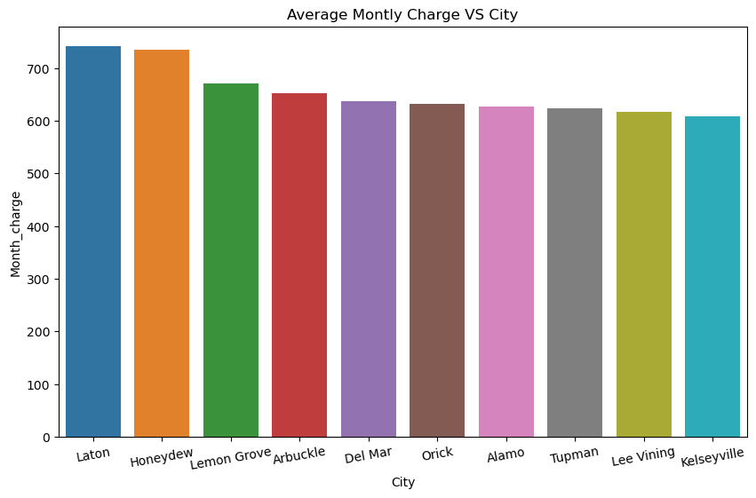


Slide 14
Analysis by the average monthly charge for our customers, and how does it vary by demographic :
City | Average
Acampo | 103.11
Jamul | 102.25
Lytle Creek | 101.96
Venice | 101.94
Yucaipa | 101.63
Meadow Vista | 101.46
Manchester | 100.78
Mineral | 100.26
King City | 100.26
South Gate | 98.62
The Average monthly charge for our customer is 63.59 and demographic wise Acampo City is highest Average monthly charge and other its vary by demographic shown in the graph.

Slide 15
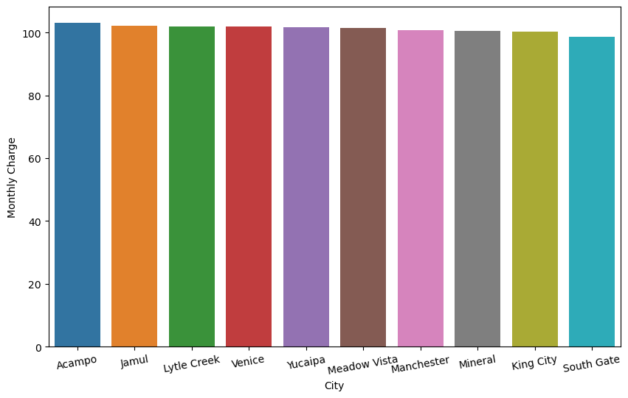

Slide 16
Analysis the most popular offers among our customer base :
Offer | Count
Offer A | 520
Offer B | 824
Offer C | 415
Offer D | 602
Offer E | 805
Offer B is the most popular offers among the 824 customer base is and also Offer E has popular in the customer value with 805 customer.

Slide 17
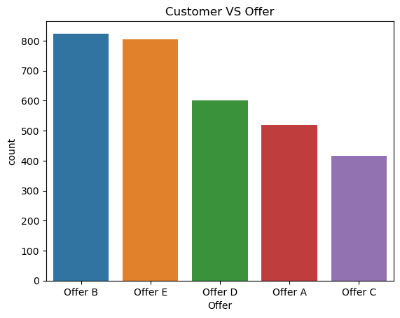

Slide 18
Analysis by types of internet services do our customers prefer, and are there any trends in usage :
Internet Service
Yes | No
5517 | 1526
Internet Type | Unlimited Data | Total
Cable | Yes | 715
Cable | No | 115
DSL | Yes | 1414
DSL | No | 238
Fiber Optic | Yes | 2616
Fiber Optic | No | 419
There are 5517 customer using interview service and there are Cables & Fiber Optics type but Fiber Optic Type & Unlimited Data is used by 2616 customer also DSL Type & Unlimited Data used by 1414 customer.

Slide 19
Is there a relationship between premium tech support services and customer churn :
Premium Tech Support | Customer Status | Total Customer
Yes | Stayed | 1687
 | Churned | 310
 | Joined | 47
No | Stayed | 1802
 | Churned | 1446
 | Joined | 225
we've observed a notable trend: customers who opt for premium tech support to have longer tenure with us and are less likely to churn compared to customers who do not opt for premium support. This suggests that offering premium tech support services can positively impact customer retention and loyalty.

Slide 20
Analysis by customers subscribe to device protection plans, and does it correlate with satisfaction :
Device Protection Plan
Yes | No
2422 | 3095
Device Protection Plan | Customer Status | Total Customer
Yes | Stayed | 1845
 | Churned | 545
 | Joined | 32
No | Stayed | 1644
 | Churned | 1211
 | Joined | 240
The 2422 customer has take device Protection Plan and 2845 customer has satisfied with our service and 32 new customer has joined us but we analysis that 545 customer has churned .

Slide 21
Analysis the streaming services are most popular among our customer base, and do they impact retention
Streaming Movies
Streaming TV
Streaming Music
Yes | No
2732 | 2785
Yes | No
2488 | 3029
Yes | No
2707 | 2810
Streaming Movies as the predominant service, favored by a substantial 2732 customers. Additionally, Streaming TV emerges as another highly popular service, enjoyed by 2707 customers.

Slide 22

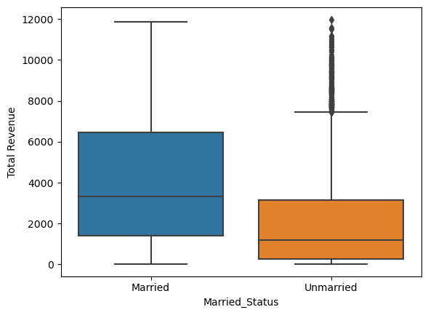
Analysis by marital status impact customer on spending habits :
Marital Status
Married | Un-Married
13645092.25 | 7726039.44
Married individuals exhibit higher spending compared to unmarried counterparts. This indicates a potential correlation between marital status and spending behavior.

Slide 23
Analysis the average monthly GB download vary across different customer segments :
Adult | Old | Young
15.23 | 15.11 | 41.92
The Young has maximum average monthly GB Download its 41.92 GB and Adult and old has also 15.73 GB and 14.73GB.
Analysis How long do customers typically stay with our company (tenure) segment wise :
Adult | Old | Young
32.19 | 32.80 | 32.37
Are customers with multiple lines more likely to stay with the company long-term
Month-to-Month | Two Year | One Year
1347 | 974 | 650
The less number of customer has likely stay with the company long term. maximum customer has stay with Month-to-Month. The only Two Year 974 .

Slide 24
Analysis by different payment methods correlate with customer satisfaction and retention :
Payment Method | Customer Status | Total Customer
Bank Withdrawal | Stayed | 2399
 | Churned | 1329
 | Joined | 181
Credit Card | Stayed | 2120
 | Churned | 398
 | Joined | 231
Mailed Check | Stayed | 201
 | Churned | 142
 | Joined | 42
Bank Withdrawal emerges as the preferred payment method among customers, with a majority choosing to stay with our services. Additionally, customers utilizing Credit Card payments also demonstrate a strong inclination to remain with us. However, Mailed Check payments exhibit lower retention rates compared to other methods. Notably, Bank Withdrawal customers experienced 1329 instances of churn.

Slide 25
why customer is churned what was reason and how much customer churned :
Customer Status | Churn Category | Total Customer
Churned | Competitor | 841
 | Dissatisfaction | 321
 | Attitude | 314
 | Price | 211
 | Other | 182
Customer churn categorized into various factors, including competition from rivals, customer dissatisfaction, attitude towards the service, pricing issues, and other miscellaneous reasons. The majority of churn is attributed to competition from competitors, followed by dissatisfaction with the service, attitude problems, pricing concerns, and other unspecified reasons.

Slide 26
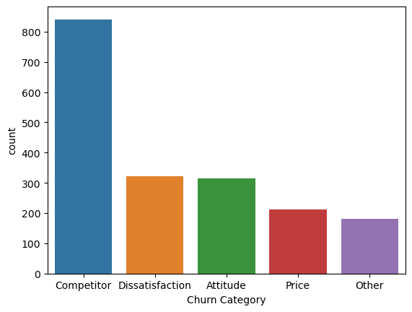

Slide 27
Insights into the characteristics of customers categorized under Competitor churn?
Churn Category | Churn Reason | Total Customer
Competitor | Competitor had better devices | 841
 | Competitor made better offer | 321
 | Competitor offered more data | 314
 | Competitor offered higher download speeds | 211
In the churn category of customers attributed to the competitor, 313 customers have churned due to the competitor offering better devices and more enticing offers compared to our services. Additionally, the competitor boasts higher download speeds, which have influenced customer decisions to switch from our service.

Slide 28
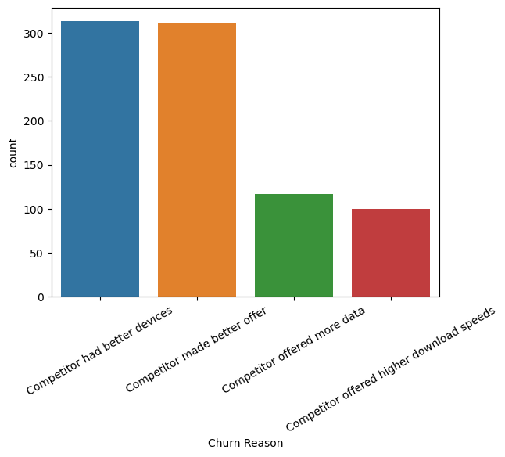

Slide 29
Achievements
- Implemented a predictive churn model, resulting in a increase in the accuracy of identifying at-risk customers.
- Developed and deployed targeted retention campaigns, leading to a reduction in churn rates.
- Utilized Python insights to improve customer service processes, addressing pain points and enhancing overall customer satisfaction.
Technologies and Tools
- Expertise in data analysis and visualization using Python.
- Applied statistical modeling and machine learning techniques for predictive churn analysis.
- Utilized SQL and other data manipulation tools for efficient data preparation
Results and Impact
- Significantly contributed to reducing churn rates, resulting in improved customer retention and revenue stability.
- Received recognition for the successful implementation of data-driven strategies, positively impacting the bottom line.

Slide 30
Skills Developed
- Predictive modeling for customer churn analysis.
- Advanced data visualization and interpretation using Python .
- Collaborative problem-solving with cross-functional teams in the telecom industry

Slide 31


Thank's For Watching
Connect with us.
9511006043
rajkadam672001@gmail.com

